Slide 1

DEPARTMENT OF COMPUTER ENGINEERING
Absolute Journal
Student name: Bismita Patro Roll no: 04 Division: C
Student name: Mokshada Sawant Roll no: 23 Division: C
Student name: Pranay Patil Roll no: 02 Division: C
Year and Semester: T.E. (SEM VI)

Slide 2
Problem Statement
In this digital era, anything can be obtained over the internet, so people don't have to deal with any inconveniences or waste most of our time and also the books aren’t available in the library most of the time as they are in limited quantity.
We believe that academic inquiry should be accessible to everyone, and that all voices and perspectives have a place in the academic conversation.
Our project is committed to promoting diversity, equity, and inclusion in all aspects of our work, and we strive to create a welcoming and supportive community for all students.

Slide 3
Objective:
To develop a highly accessible web-app where all kinds of notes, pdfs and books are available.
To provide an organized collection of all the materials available.
To make a Dynamic web-app which can then be updated as and when the user uploads data.
To make an engaging user-interface.
To make books, notes and pdf available to all registered users.
To make a discussion box for sharing, receiving and upgrading one
another’s knowledge.

Slide 4
Scope & Features:
In the event that information is the cash of the information economy, digital libraries are where it is contributed. Our project Absolute Journal is exclusively for the computer branch of A. P. Shah institute of technology.
Herein all the subjects from all four years of engineering will be available.
Amongst several other features, notes from various teachers for the same subject will be available. This will help the students to gain a clearer idea about a certain topic that they may have found difficult previously.
Students sharing their ideas and notes will also help making the web application interactive.

Slide 5
Technology Stack:
Software Requirements:
HTML
CSS
Javascript
SQL Lite
Python
AWS Cloud

Slide 6
Description:
AWS VPC:A VPC, or Virtual Private Cloud, is a virtual network environment that provides a private and isolated network space within the public cloud infrastructure of Amazon Web Services (AWS), including EC2 (Elastic Compute Cloud). By using a VPC, you can create a logically isolated section of the AWS Cloud, in which you can launch AWS resources such as EC2 instances, RDS instances, and Elastic Load Balancers.
AWS EC2:Amazon Elastic Compute Cloud (EC2) is a cloud computing service provided by Amazon Web Services (AWS). It enables users to rent virtual computers, called instances, in the AWS cloud, and run applications and workloads on these instances.
Amazon S3 (Simple Storage Service):It is a cloud-based object storage service offered by Amazon Web Services (AWS). It allows users to store and retrieve large amounts of data from anywhere on the web, at any time, with virtually unlimited capacity.

Slide 7
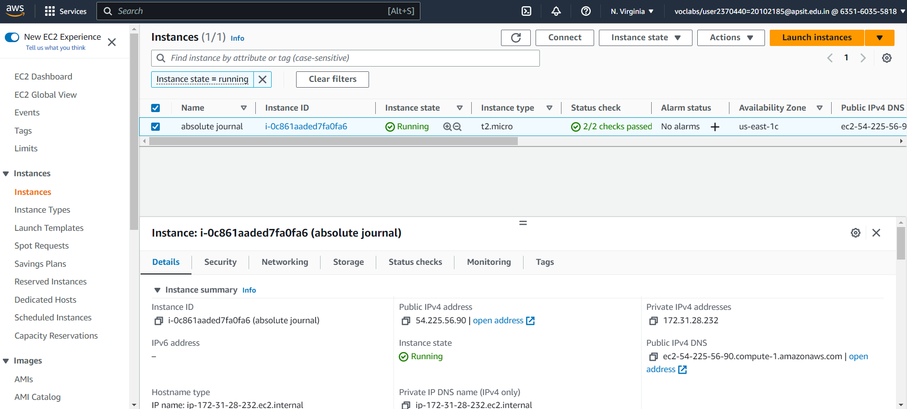
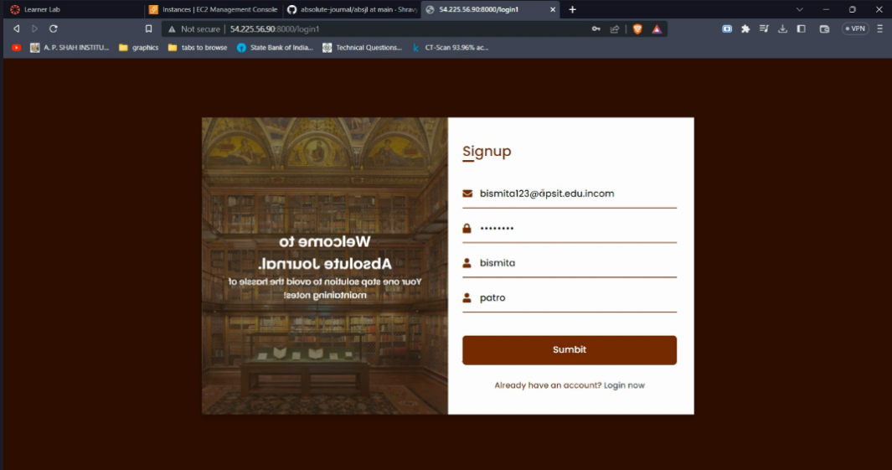
Implementation Details with Screenshots:

Slide 8
References
Reference 1:
https://www.researchgate.net/publication/28804374_Digital_reference_service_libraries_online_247
Reference 2:
https://www.youtube.com/watch?v=MAsp90tQGOA

Slide 9
References
Reference 3 -
https://ieeexplore.ieee.org/document/6295395
Reference 4 -
http://www.worldscientificnews.com/wpcontent/
uploads/2015/07/WSN-24-2015-1-7.pdf

Slide 10
Thank You!

